Slide 1
Strategies for Reading Poetry
I will let you use your notes on your poetry tests and quizzes

Slide 2
1. Consider the Title of the Poem: read the title, read the poem, then read the title again.
These are probably not random titles. Titles are chosen by the poet and are important.
What might the title mean? What might it suggest? What if there isn’t a title?
What can you guess about the poem, just from the following titles:
“My Last Duchess”
“Do Tell”
“For Mr. Grimes Who Tried To Teach Me Physics After My Father Died”
“The Spaces above and Below My Feet”

Slide 3
2. Consider the literal, then the implied meanings
Poets frequently show, rather than tell, what’s going on. This requires some investigation on our part.
1. Figure out the literal meaning first: what is the story of the poem in its simplest form.
2. Consider the deeper or implied meanings in the stanza below. The meaning expands as we do this:
I call her up sometimes, long distance now.
And she still knows my voice, but I can hear,
Beyond the music of her phonograph,
The laughter of young men with their keys.

Slide 4
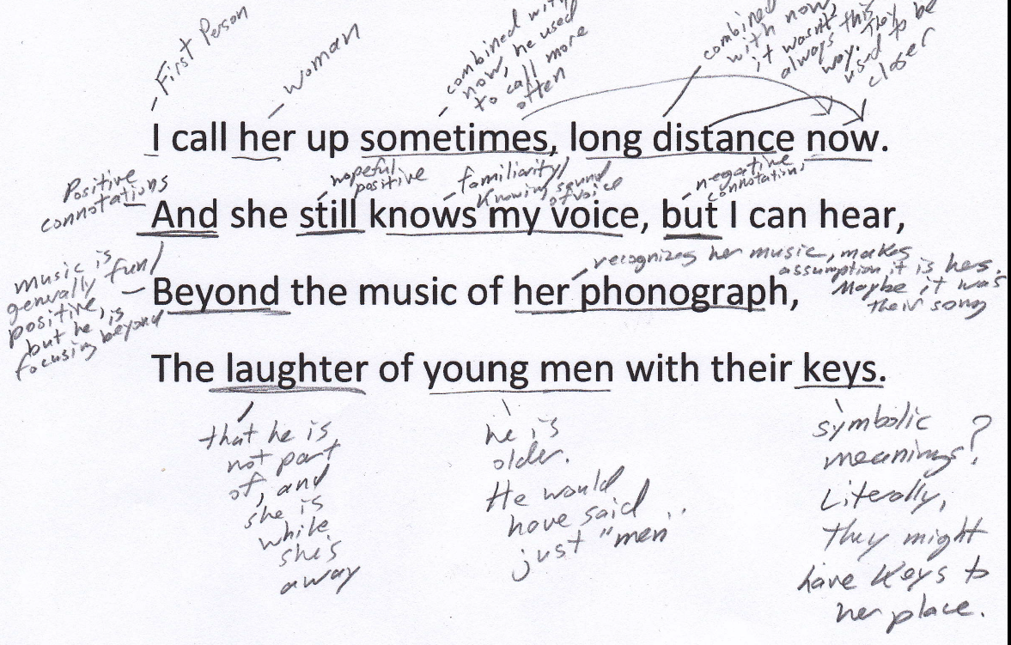
Always Annotate the Poem

Slide 5
3. Consider the speaker of the poem and the spoken-to (first-person poems)
Who is the speaker? Who is being spoken to?: how old are they? Male or female? Where are they located? What are they doing? What are their attitudes?
In a difficult poem, considering these simple questions can all lead you to meaning
Look at the example of “the bluebird”

Slide 6
4. Theme
The previous steps should lead you to a statement of theme: what is the central message of the text, what do we learn about life from having read it.
You get theme from a text, but it must be applicable to life in general.
Always include a statement of theme in your interpretations with specific details from the poem to back it up.
Motif: a recurring idea. Ex.: love, death, disease, hate. Don’t mistake this for theme. Theme comes from motif, but they are not the same thing.

Slide 7
5. Form: Look at the way the poem appears on the page
Shape “The Affair”
Arrangement of words Ex. “Suppose Columbus”
Length of lines Ex. “Do Tell”
enjambment Ex. “Rite of Passage”
Rhyme scheme
Fixed form?

